Slide 1


4CCS1IAI: Introduction to Artificial Intelligence
Artificial Intelligence Planning

Slide 2
Artificial Intelligence Planning
Planning is about determining actions before doing them, anticipating the things that will need to be done and preparing for them
If you have a goal to achieve and to do so you need to decide what to do, when to do it and what to use, then that’s planning
Planning is usually done by (teams of) humans: automated planning is for when this job needs to be done fast, frequently, or is too complicated for humans
Where there is money to be made, pollution to reduce, productivity to increase, resources to be managed, planning can do it.

Slide 3
Artificial Intelligence Planning
At King’s we use AI Planning in the following domains:
Underwater Robotics
Autonomous Drones
Urban Traffic Control
Autonomous Robots
Smart Grid and Unit Commitment Problem
Hybrid Cars
Battery Management Systems
Air traffic control
Mars Rover
BSc projects, MSc project, PhDs….

Slide 4
AI Planning
Given:
An initial state I
A goal state G
A set of actions
Find:
A plan (a sequence of actions that bring the system from I to G)
More interesting: finding an optimal plan (that is the best way to reach the goal state)

Slide 5
The Logistics Domain
Constraints:
Fuel
Truck capacity
Number of drivers
…
…
Initial State
Cargos
Trucks
Goal: all cargos at a destination point
Destination point

Slide 6
The Logistics Domain: Problem Modelling
We need to define:
The objects involved in the problem
The relations between the objects
The set of possible actions (with preconditions and effects)

Slide 7
The Logistics Domain: Objects and Relations
Objects:
The cargos (c₁,…,c_{n})
The trucks (t₁,…,t_{m})
The locations (l₁,…,l_{k})
Relations:
Pairs of location can be connected: connected(l_{i},l_{j})
Each truck is in a given location: at(t_{i},l_{j})
Each cargo can be in a given location: at(c_{i},l_{j})
Each cargo can be on a truck: on(c_{i},t_{j})

Slide 8
From the General Description to a Specific Problem
We have to define the initial state and the goal state.
initial state
we have to list:
all the objects of our problem
all the true relations among the objects
Closed-world assumption: what is not listed is assumed to be false
goal state
we have to list:
all the relations we want to be true

Slide 9
The Logistics Domain: the Initial State
Let’s consider the case where we have 2 trucks, 3 cargos and 8 locations
l1
l2
l6
at(c₁,l₃)
at(c₂,l₄)
at(c₃,l₈)
at(t₁,l₁)
at(t₂,l₅)
connected(l₁, l₂), connected(l₂, l₃), connected(l₃, l₄), connected(l₃, l₈)
connected(l₄, l₇), connected(l₅, l₆), connected(l₆, l₇), connected(l₇, l₈)
l4
l3
l7
l8
l5
From the closed-world assumption, it follows that, for example:
l1 and l6 are not connected, truck t1 is not at location 8, all trucks are empty, etc...
Goal state: all cargos in location l6

Slide 10
The Logistics Domain: the Actions
Informally...
A truck can move from one location to another (move)
A cargo can be loaded into a truck (load)
A cargo can be unloaded from a truck (unload)
More formally...
For each action, we have to define
The parameters (which objects are involved in the action?)
The preconditions (when can the action be applied ?)
The effects (how does the state change after the action execution ?)
Preconditions are described through a set of relations (that must be true in a state for the action to be applicable)
Effects are described by adding or deleting relations

Slide 11
The Logistics Domain: the Actions
Action | Parameters | Preconditions | Effects
Move | truck t location from location to | at(t,from) connected(from,to) | + at(t,to) - at(t,from)
Preconditions are described through a set of relations (that must be true in a state for the action to be applicable)
Effects are described by adding or deleting relations

Slide 12
The Logistics Domain: the Actions
Action | Parameters | Preconditions | Effects
Move | truck t location from location to | at(t,from) connected(from,to) | + at(t,to) - at(t,from)
Load | truck t cargo c location l | at(t,l) at(c,l) | + on(c,t) - at(c,l) at,(t,l) ?!?
Preconditions are described through a set of relations (that must be true in a state for the action to be applicable)
Effects are described by adding or deleting relations

Slide 13
The Logistics Domain: the Actions
Action | Parameters | Preconditions | Effects
Move | truck t location from location to | at(t,from) connected(from,to) | + at(t,to) - at(t,from)
Load | truck t cargo c location l | at(t,l) at(c,l) | + on(c,t) - at(c,l) at,(t,l) ?!?
Unload | truck t cargo c location l | at(t,l) on(c,t) | + at(c,l) - on(c,t)
Preconditions are described through a set of relations (that must be true in a state for the action to be applicable)
Effects are described by adding or deleting relations

Slide 14
The Logistics Domain: a Plan
Initial State
Goal State
l1
l1
l2
l2
l4
l6
l4
l6
l3
l7
l3
l7
l8
l8
l5
l5
Plan
Truck1: m(l1,l2),m(l2,l3),load(c1),m(l3,l4),load(c2),m(l4,l7),l6,unload(c1),unload(c2)
Truck2: m(l5,l6),m(l6,l7),move(l7,l8),load(c3),m(l8,l7),m(l7,l6),unload(c3)
Note that t1 and t2 can move in parallel!

Slide 15
The Logistics Domain: a Plan
Initial State
Goal State
l1
l1
l2
l2
l4
l6
l4
l6
l3
l7
l3
l7
l8
l8
l5
l5
What if we have
75 locations
40 cargos
12 trucks + AIRPLANES
(or more!!!) ?

Slide 16
The Logistics Domain: a Plan
Initial State
Goal State
l1
l1
l2
l2
We need a planner !
l4
l6
l4
l6
l3
l7
l3
l7
l8
l8
l5
l5
What if we have
75 locations
40 cargos
12 trucks + AIRPLANES
(or more!!!) ?

Slide 17
Planners
Zeno
FF
MetricFF
VHPOP
Marvin
Crikey
POPF
MIPS-XXL
LPGP
LPRPG
CoLin
Fast Downward
UPMurphi
Gamer
MBP
...
...
International Planning Competition

Slide 18
PDDL Planning Domain Definition Language
Standard language spoken by the planners
If you write a correct model of your planning problem in PDDL, then you can use existing planners to easily solve your problem
Different versions (levels) of PDDL, each one able to handle different features.
Some examples:
PDDL : propositional planning
PDDL2.1 : numbers + time
PDDL3 : preferences
PDDL+ : continuous change, processes, events

Slide 19
PDDL Planning Domain Definition Language
A PDDL Planning Model is described through two files:
A domain file
2. A problem file
General description of the world.
Which types of objects are involved,
What actions can be applied, etc ...
Specific situation you want to solve.
List of objects, initial state, goal state.
Problem2
Problem3
Problem4
Problem5
Problem1
Domain
Problem8
Problem7
Problem6

Slide 20
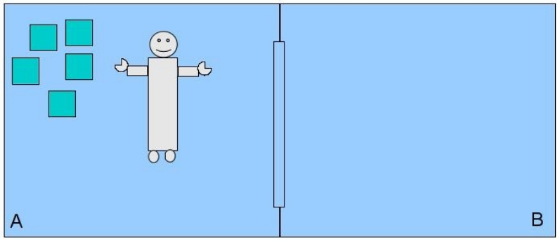
The Gripper Domain
A robot can move between two rooms and pick up or drop balls with either of his two arms.
The initial state: boxes b1..b5 in room A, robot in room A
The goal state: boxes b1..b5 in room B, robot in room B
The actions:
Pick up a box in a gripper
Drop a box
Move from one room to the other

Slide 21
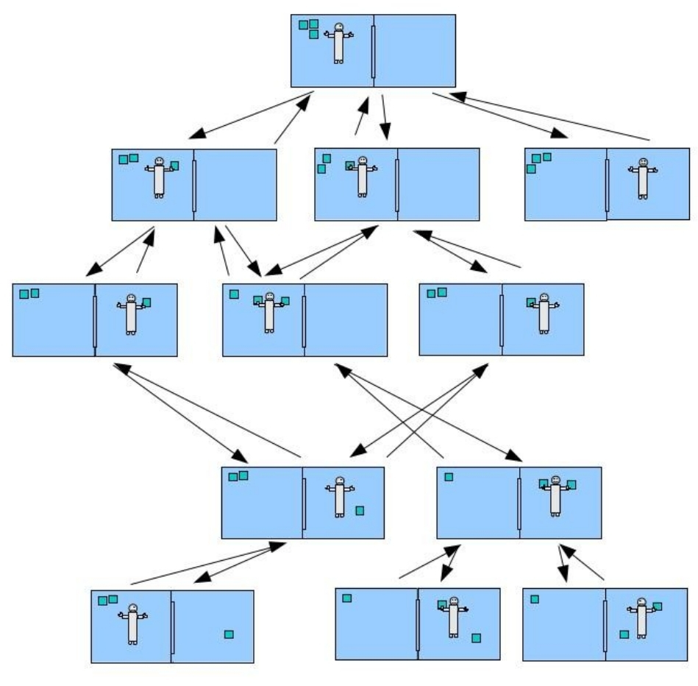
The Gripper Domain
(Partial) state space exploration

Slide 22
The Gripper Domain
A robot can move between two rooms and pick up or drop balls with either of his two arms.
Objects:
Predicates:
Action | Parameters | Preconditions | Effects
Move | Room x Room y | at-robot(x) | at-robot(y) - at-robot(x)
PickUp | Room x Ball b Gripper g | at-robot(x) at(b,x) free(g) | + carry(g,b) at(b,x) free(g)
Drop | Room x Ball b Gripper g | at-robot(x) carry(g,b) | + at(b,x) + free(g) carry(g,b)
The actions:
Pick up a box in a gripper
Put down a box
Move from one room to the other

Slide 23
The Gripper Domain in PDDL
Objets:
(:objects rooma roomb - location
ball1 ball2 ball3 ball4 - ball
left right - gripper)
Predicates
(:predicates (at-robot ?l - location) (at-ball ?b - ball ?l - location)
(free ?g - gripper) (carry ?g – gripper ?b - ball))

Slide 24
The Gripper Domain in PDDL
Initial state:
(:init
(free left) (free right)
(at-robot rooma)
(at-ball ball1 rooma) (at-ball ball2 rooma)
(at-ball ball3 rooma) (at-ball ball4 rooma))

Slide 25
The Gripper Domain in PDDL
Goal state:
(:goal (and (at-ball ball1 roomb)
(at-ball ball2 roomb)
(at-ball ball3 roomb)
(at-ball ball4 roomb)))

Slide 26
The Gripper Domain in PDDL
Action move
(:action move
:parameters (?x - location ?y - location)
:precondition (and (at-robot ?x))
:effect
(and (at-robot ?y)
(not (at-robot ?x))))

Slide 27
The Gripper Domain in PDDL
Action pick-up
(:action pick-up
:parameters (?b - ball ?l – location ?g - gripper)
:precondition (and (at-ball ?b ?l) (at-robot ?l)
(free ?g))
:effect
(and (carry ?g ?b)
(not (at-ball ?b ?l)) (not (free ?g))))

Slide 28
The Gripper Domain in PDDL
Action drop
(:action drop
:parameters (?b – ball ?l - location ?g - gripper)
:precondition (and (carry ?g ?b) (at-robot ?l))
:effect
(and (at ?b ?l) (free ?g)
(not (carry ?g ?b))))

Slide 29
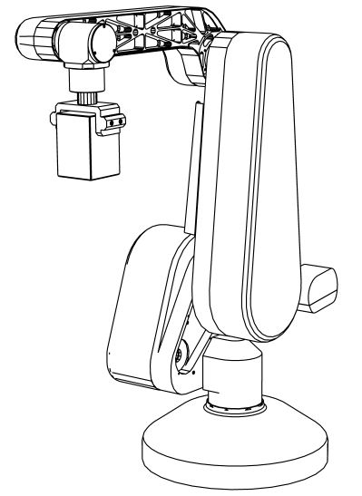
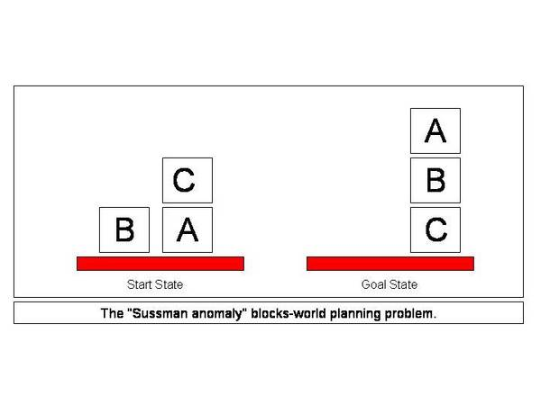
The Blocks World Domain

Slide 30
The Blocks World in PDDL
Predicates
(:predicates (on ?x ?y - block) (ontable ?x - block) (clear ?x – block)
(handempty) (holding ?x - block))
Action pick-up
Action put-down
Action stack
Action unstack

Slide 31
The Blocks World in PDDL
Action pick-up
(:action pick-up
:parameters (?x - block)
:precondition (and (clear ?x) (ontable ?x)
(handempty))
:effect (and (not (ontable ?x))
(not (clear ?x))
(not (handempty))
(holding ?x)))

Slide 32
The Blocks World in PDDL
Action put-down
(:action put-down
:parameters (?x - block)
:precondition (holding ?x)
:effect (and (not (holding ?x)) (clear ?x) (handempty)(ontable ?x)))

Slide 33
The Blocks World in PDDL
Action stack
(:action stack
:parameters (?x ?y - block)
:precondition (and (holding ?x) (clear ?y))
:effect (and (not (holding ?x))
(not (clear ?y))
(clear ?x)
(handempty) (on ?x ?y)))

Slide 34
The Blocks World in PDDL
Action unstack
(:action unstack
:parameters (?x ?y - block)
:precondition (and (on ?x ?y) (clear ?x) (handempty))
:effect (and (holding ?x) (clear ?y)
(not clear ?x))
(not (handempty))
(not (on ?x ?y)))))

Slide 35
The Blocks World Domain
(define (domain blocks)
(:predicates (on ?x ?y - block) (ontable ?x - block) (clear ?x - block) (handempty) (holding ?x- block))
(:action pick-up
:parameters (?x - block)
:precondition (and (clear ?x) (ontable ?x) (handempty))
:effect (and (not (ontable ?x)) (not (clear ?x)) (not (handempty))
(holding ?x)))
(:action put-down
:parameters (?x - block)
:precondition (holding ?x)
:effect (and (not (holding ?x)) (clear ?x) (handempty)
(ontable ?x)))
(:action stack
:parameters (?x ?y - block)
:precondition (and (holding ?x) (clear ?y))
:effect (and (not (holding ?x)) (not (clear ?y)) (clear ?x)
(handempty) (on ?x ?y)))
(:action unstack
:parameters (?x ?y - block)
:precondition (and (on ?x ?y) (clear ?x) (handempty))
:effect (and (holding ?x) (clear ?y) (not (clear ?x))
(not (handempty)) (not (on ?x ?y)))))

Slide 36
PDDL problem
Ex: describe the initial and goal states in the PDDL problem
(define (problem blocks-3)
(:domain blocks)
(:objects A B C)
(:init (ontable A) (clear B) (ontable B)
(clear C) (on C A) (handempty))
(:goal (and (on A B) (on B C)
(ontable C))
)

Slide 37
The Blocks World (Problem file)
(define (problem blocks-10)
(:domain blocks)
(:objects b1 b2 b3 b4 b5 b6 b7 b8 b9 b10)
(:init (clear b1) (ontable b1) (clear b2) (ontable b2)
(clear b3) (ontable b3) (clear b4) (ontable b4)
(clear b5) (ontable b5) (clear b6) (ontable b6)
(clear b7) (ontable b7) (clear b8) (ontable b8)
(clear b9) (ontable b9) (clear b10) (ontable b10)
(handempty))
(:goal (and (on b2 b1) (on b3 b2)
(on b4 b3) (on b5 b4)
(on b6 b5) (on b7 b6)
(on b8 b7) (on b9 b8)
(on b10 b9)))
)

